Slide 1


Capstone Java Project
By Team 15:
Nafiseh Askari
Shirin BabaeiKouros
Dinh Quan Nguyen

Slide 2

How It Works
We are going to simulate a smart charging stations with various weather conditions.
Based on each weather condition we should have the appropriate energy resources.
The energy of the charging stations should be provided by these energy resources.
Many cars may enter to the charging stations and start charging in free locations
If there is not any empty location cars can wait for specific time to reach the free location.
If there is exceeded the waiting time it should leave the stations.

Slide 3
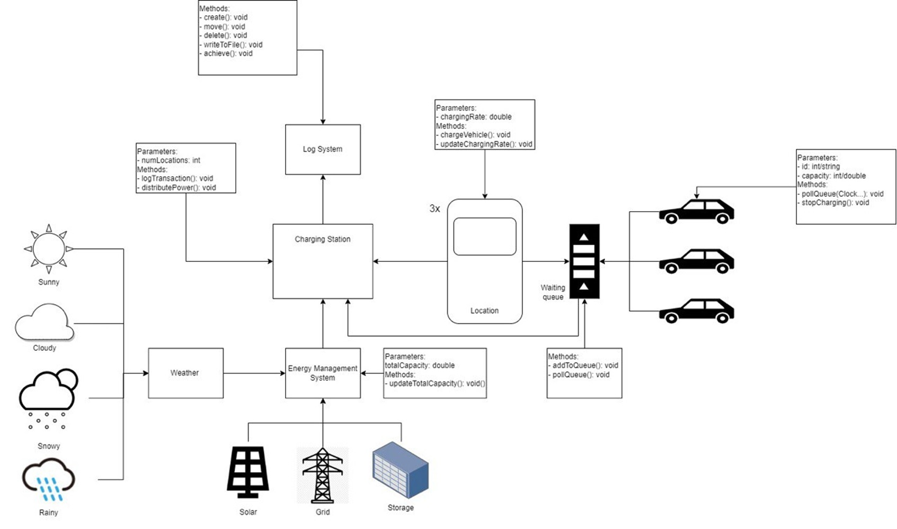
Schema of the Project

Slide 4
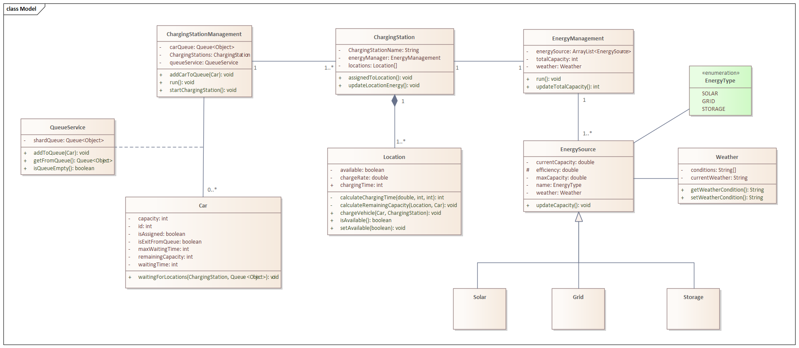
Class Diagram1

Slide 5

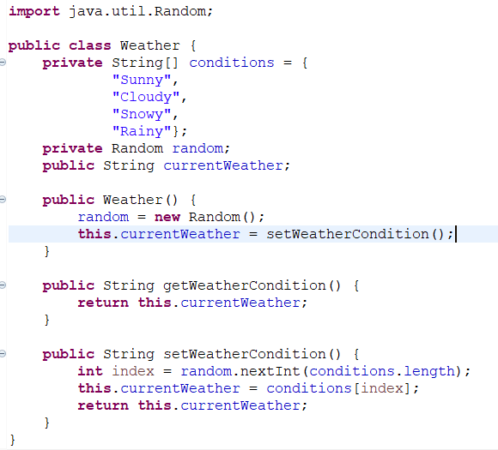
Weather Condition Part
We have created four various Weather conditions:
Sunny
Cloudy
Snowy
Rainy
For using this criteria there is a model named “Weather”.

Slide 6
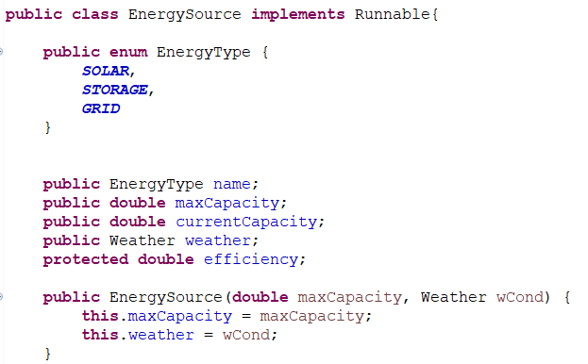
Energy Resources
There are three different resources based on the weather conditions:
SOLAR
STORAGE
GRID
Energy source class is created as parent class.

Slide 7
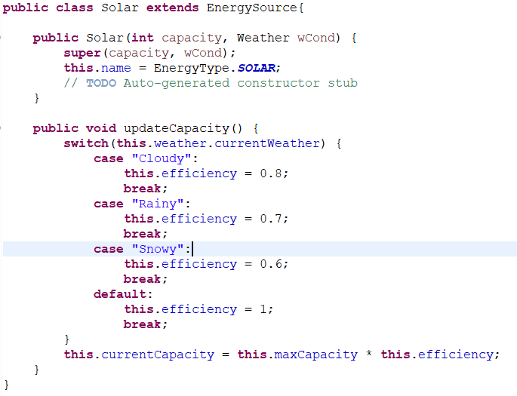
Energy Resources
Each solar , storage and grid are extended from EnergyResource and base on the weather situation the current capacity will be defined.

Slide 8
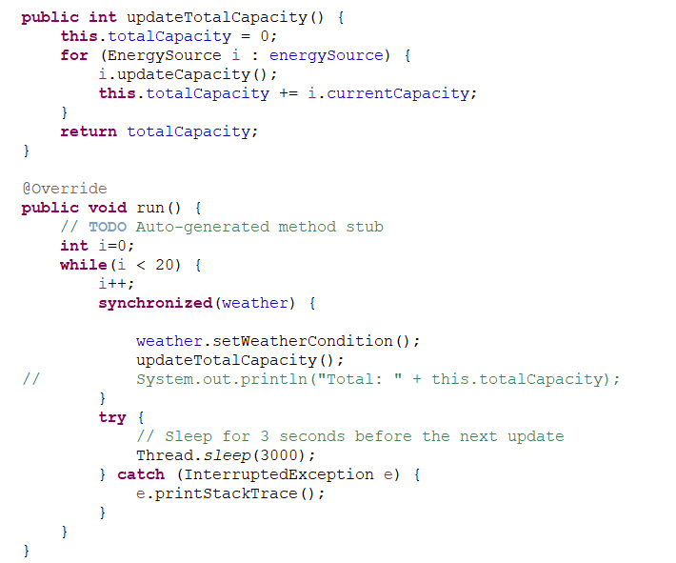
Energy Resources Management
Weather condition is randomly simulated after a time period.
A loop thread is used to continuously updated the condition independently.
synchronized(weather) is for synchronizing to protect weather condition value for updating.

Slide 9

Charging Station Management
1
2
3
Specifying the number of cars
And stations
Using Queue Service
As a shared Queue
Assigning cars to the
Charging stations
The number of cars and
stations will be determined
and that’s the time that car
s should be occupied with
locations of the
charging stations.
Cars will add to the shared linked list as queue to enter to the stations in turn.
As we have many stations and cars should be enter into them so the charging stations are the common places between cars. So, each charging stations should be considered as a thread and synchronized place that each of them should do their work synchronize.

Slide 10

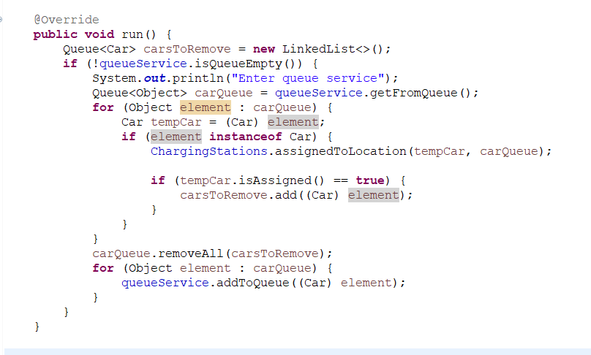
Charging station Management Method

Slide 11
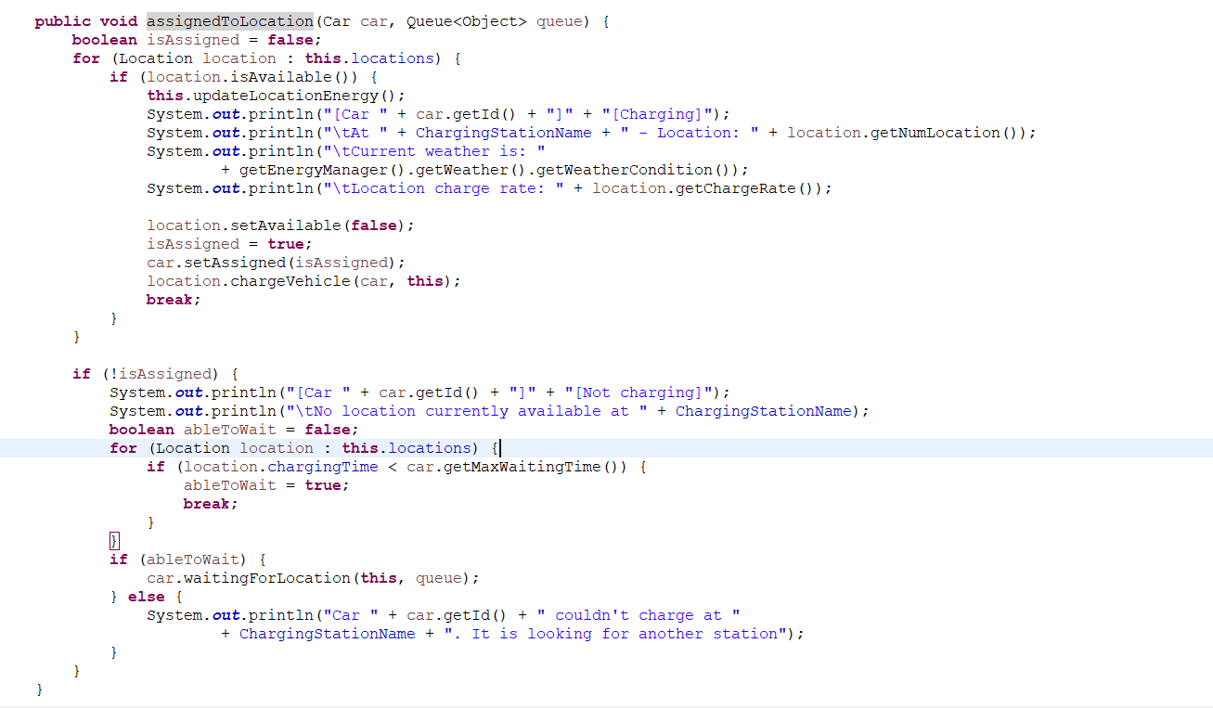
Assigning each cars to any Locations

Slide 12

Strategies of Charging Cars In Locations
1
2
3
Synchronizing
Locations
Calculating the charging time
And remain Capacity
Exiting the Location After a while
As any locations in charging
Stations should be occupied
With one car so we are using
Thread for entering cars
Into locations
After the specific time the
Car will be charged and then be exited from the queue
The remaining capacity of the car and also the
Charging time of the car will be calculated based on the
Charging rate of the location, capacity of the car,
And the remaining capacity of the car

Slide 13
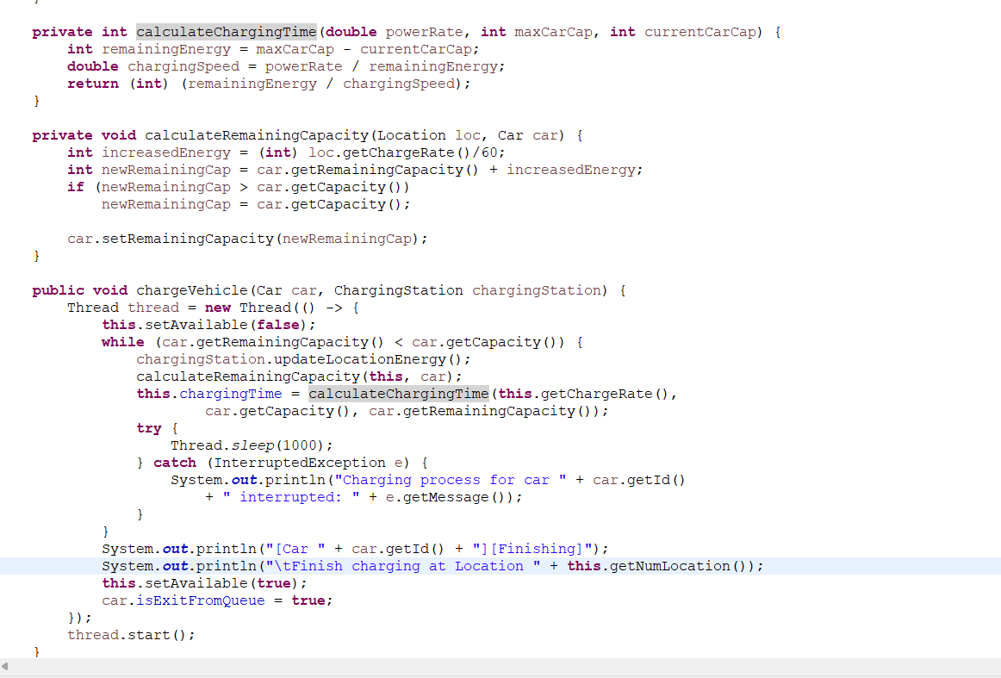
Charging Vehicle Method

Slide 14
Strategies of waiting Cars
1
2
3
Estimating the waiting time
Leaving the stations
Waiting for free
Location in the station
The maximum waiting of the
Car will be compare with the
Charging time of the location
To make decision whether
It will be able to wait for
Location or not
Else the car has the time for
Waiting at that station
To be occupied with a location.
Remaining waiting time will be calculated.
If it is smaller than zero it
Will leave the location

Slide 15
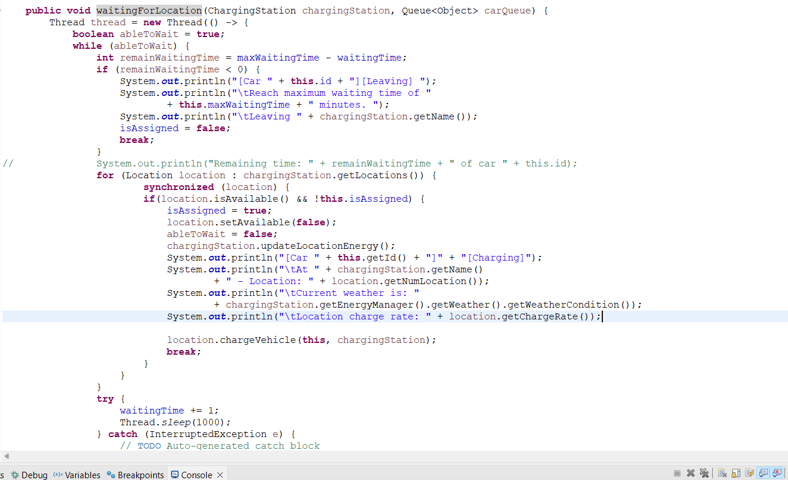
Waiting for location method

Slide 16

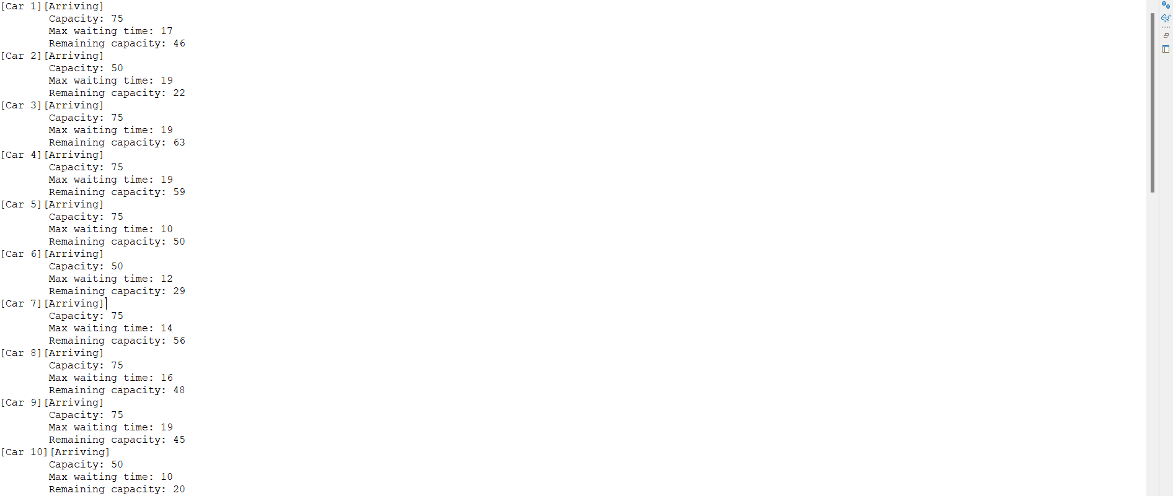
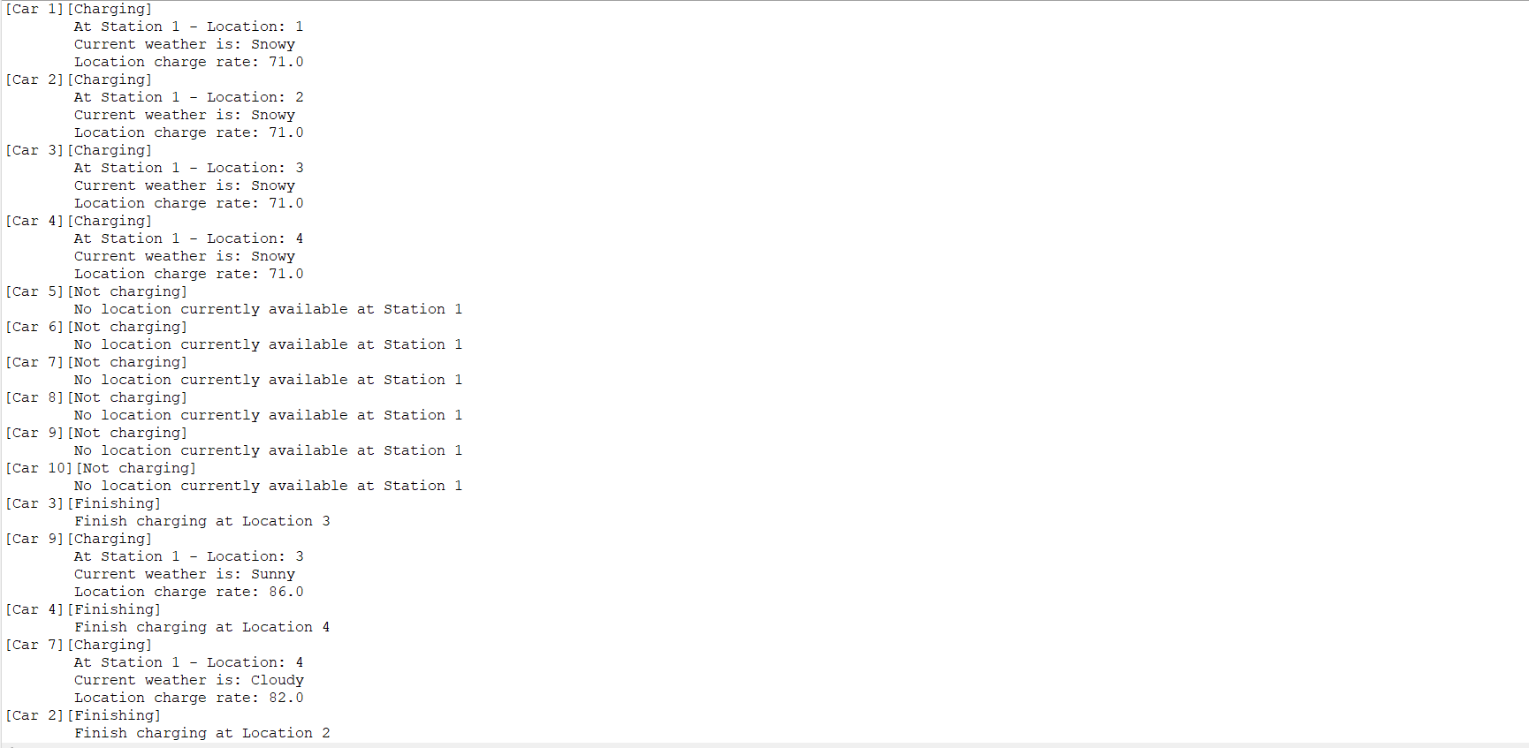
Result
1
2

Slide 17
Technical Implementation Details
High-Performance Computing
Integration with External Systems
Utilizes cutting-edge parallel processing and optimization techniques to achieve high-performance simulations.
Seamless integration with external data sources and systems to enrich simulation inputs and outputs.
Robust Error Handling
Implements effective error handling mechanisms to ensure stability and reliability during simulation executions.

